Slide 1
Standard Exceptions - C++

Slide 2
About Myself
Kamalasubha Muthukumar
Working as Senior Software Engineer in MulticorewareInc
8+ years experience in C++
LinkedIn - https://www.linkedin.com/in/kamalasubha-muthukumar-375a02120/

Slide 3
Exceptions handling
Exceptions are thrown during runtime
Example are,
  Opening a file that not exists
  Running out of memory etc
Process of handling these exceptions called Exception handling
C++ have inbuilt feature of Exception handling using following keyword : try, catch and throw statements.

Slide 4
Why Exception handling is used?
Separation of Error Handling and Normal Code
Functions/methods can handle exceptions in whatever way they want
Exceptions can be thrown in C++ for both basic types and artifacts

Slide 5
std::exceptions

Slide 6
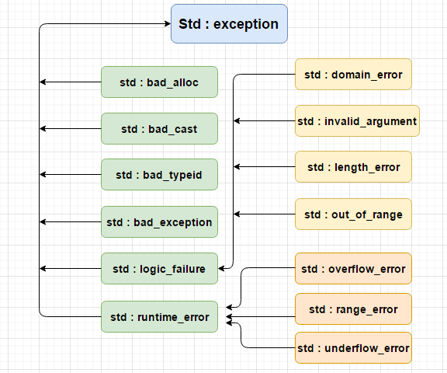
std::future_error
std::bad_weak_ptr
std::regex_erroar

Slide 7
std::logic_error

Slide 8
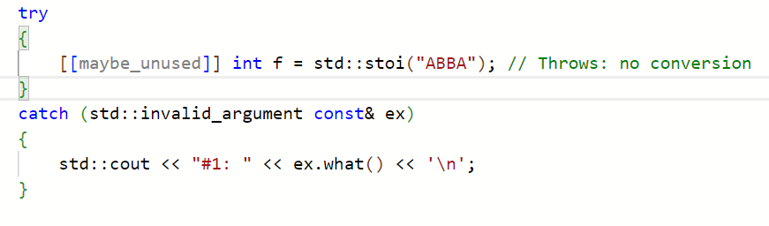
std::invalid_argument

Slide 9
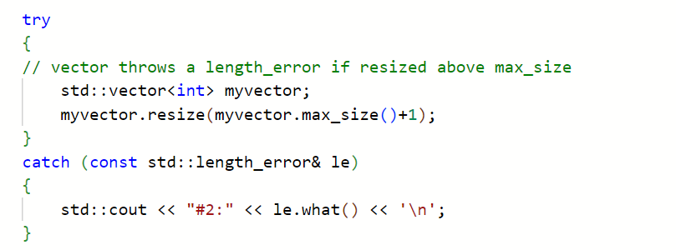
std::length_error

Slide 10
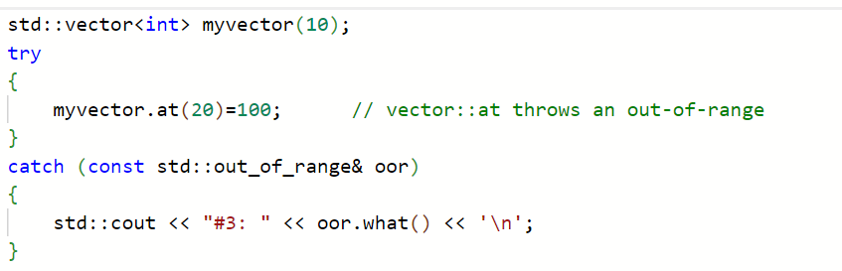
std::out_of_range

Slide 11
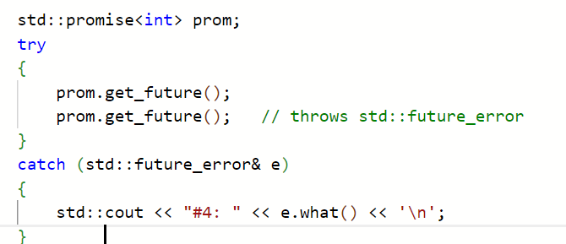
std::future_error

Slide 12
std::runtime_error

Slide 13
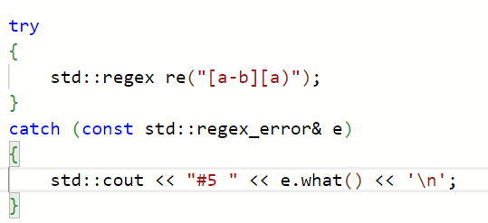
std::regex_error

Slide 14
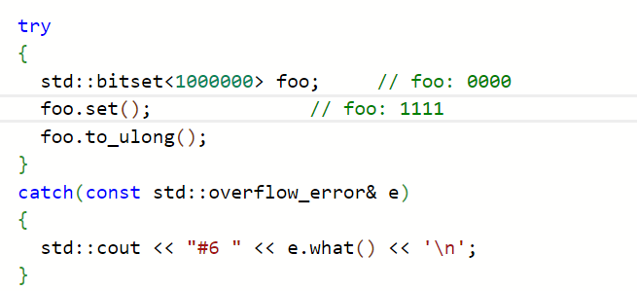
std::overflow_error

Slide 15
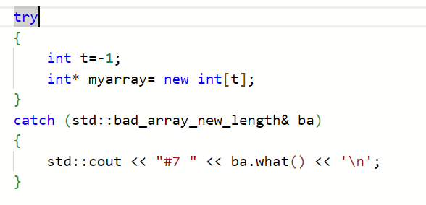
std::bad_array_length

Slide 16
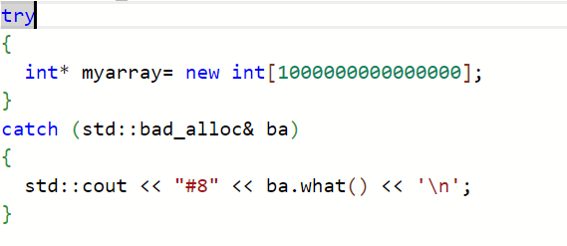
std::bad_alloc

Slide 17
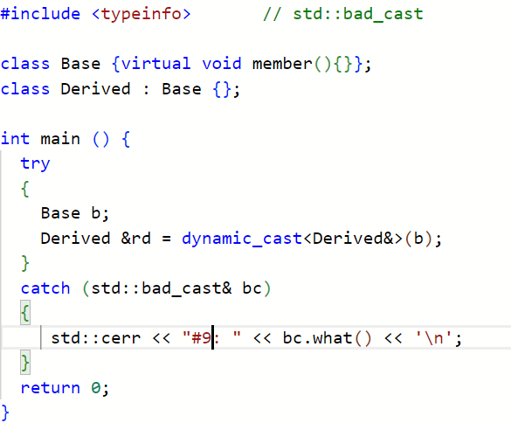
std::bad_cast

Slide 18
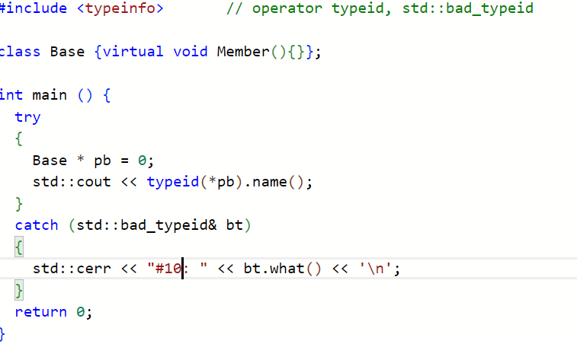
std::bad_type_id

Slide 19
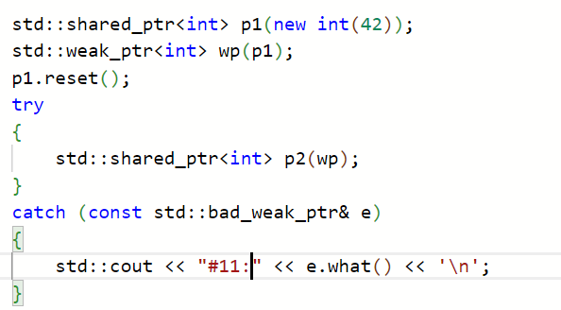
std::bad_weak_ptr

Slide 20
Any Questions?

Slide 21
Reference links
https://cplusplus.com/
https://en.cppreference.com/w/cpp/error/exception
https://simplesnippets.tech/cpp-exception-handling/
https://www.simplilearn.com/tutorials/cpp-tutorial/exception-handling-in-cpp

